Slide 1
Unit 1 | Semiconductor Physics
A | Classification of Solids on the basis of energy band, electrons and holes concentration in intrinsic semiconductors, Fermi levels, Mobility, conductivity, | CO1
B | Donor and Acceptor impurities (n-type and p-type semiconductor), Drift and diffusion current, Hall effect, | CO1
C | p-n junction, types of p-n junction (step-graded and Linearly-graded junction), formation of depletion region, barrier potential, Zener diode, Avalanche and Zener breakdown. | CO1, CO6

Slide 2
Electron Bands
Formation of Bands in Solids
Electrons revolve around the nucleus in defined shells
K 2 electrons
L 8 electrons
M 18 electrons
N 32 electrons
Within each shell, electrons are further grouped into subshells
s 2 electrons
p 6 electrons
d 10 electrons
f 14 electrons
electrons are assigned to shells and subshells from inside out
Si has 14 electrons: 2 K, 8 L, 4 M
L
K
d
p
s
10
6
2

Slide 3
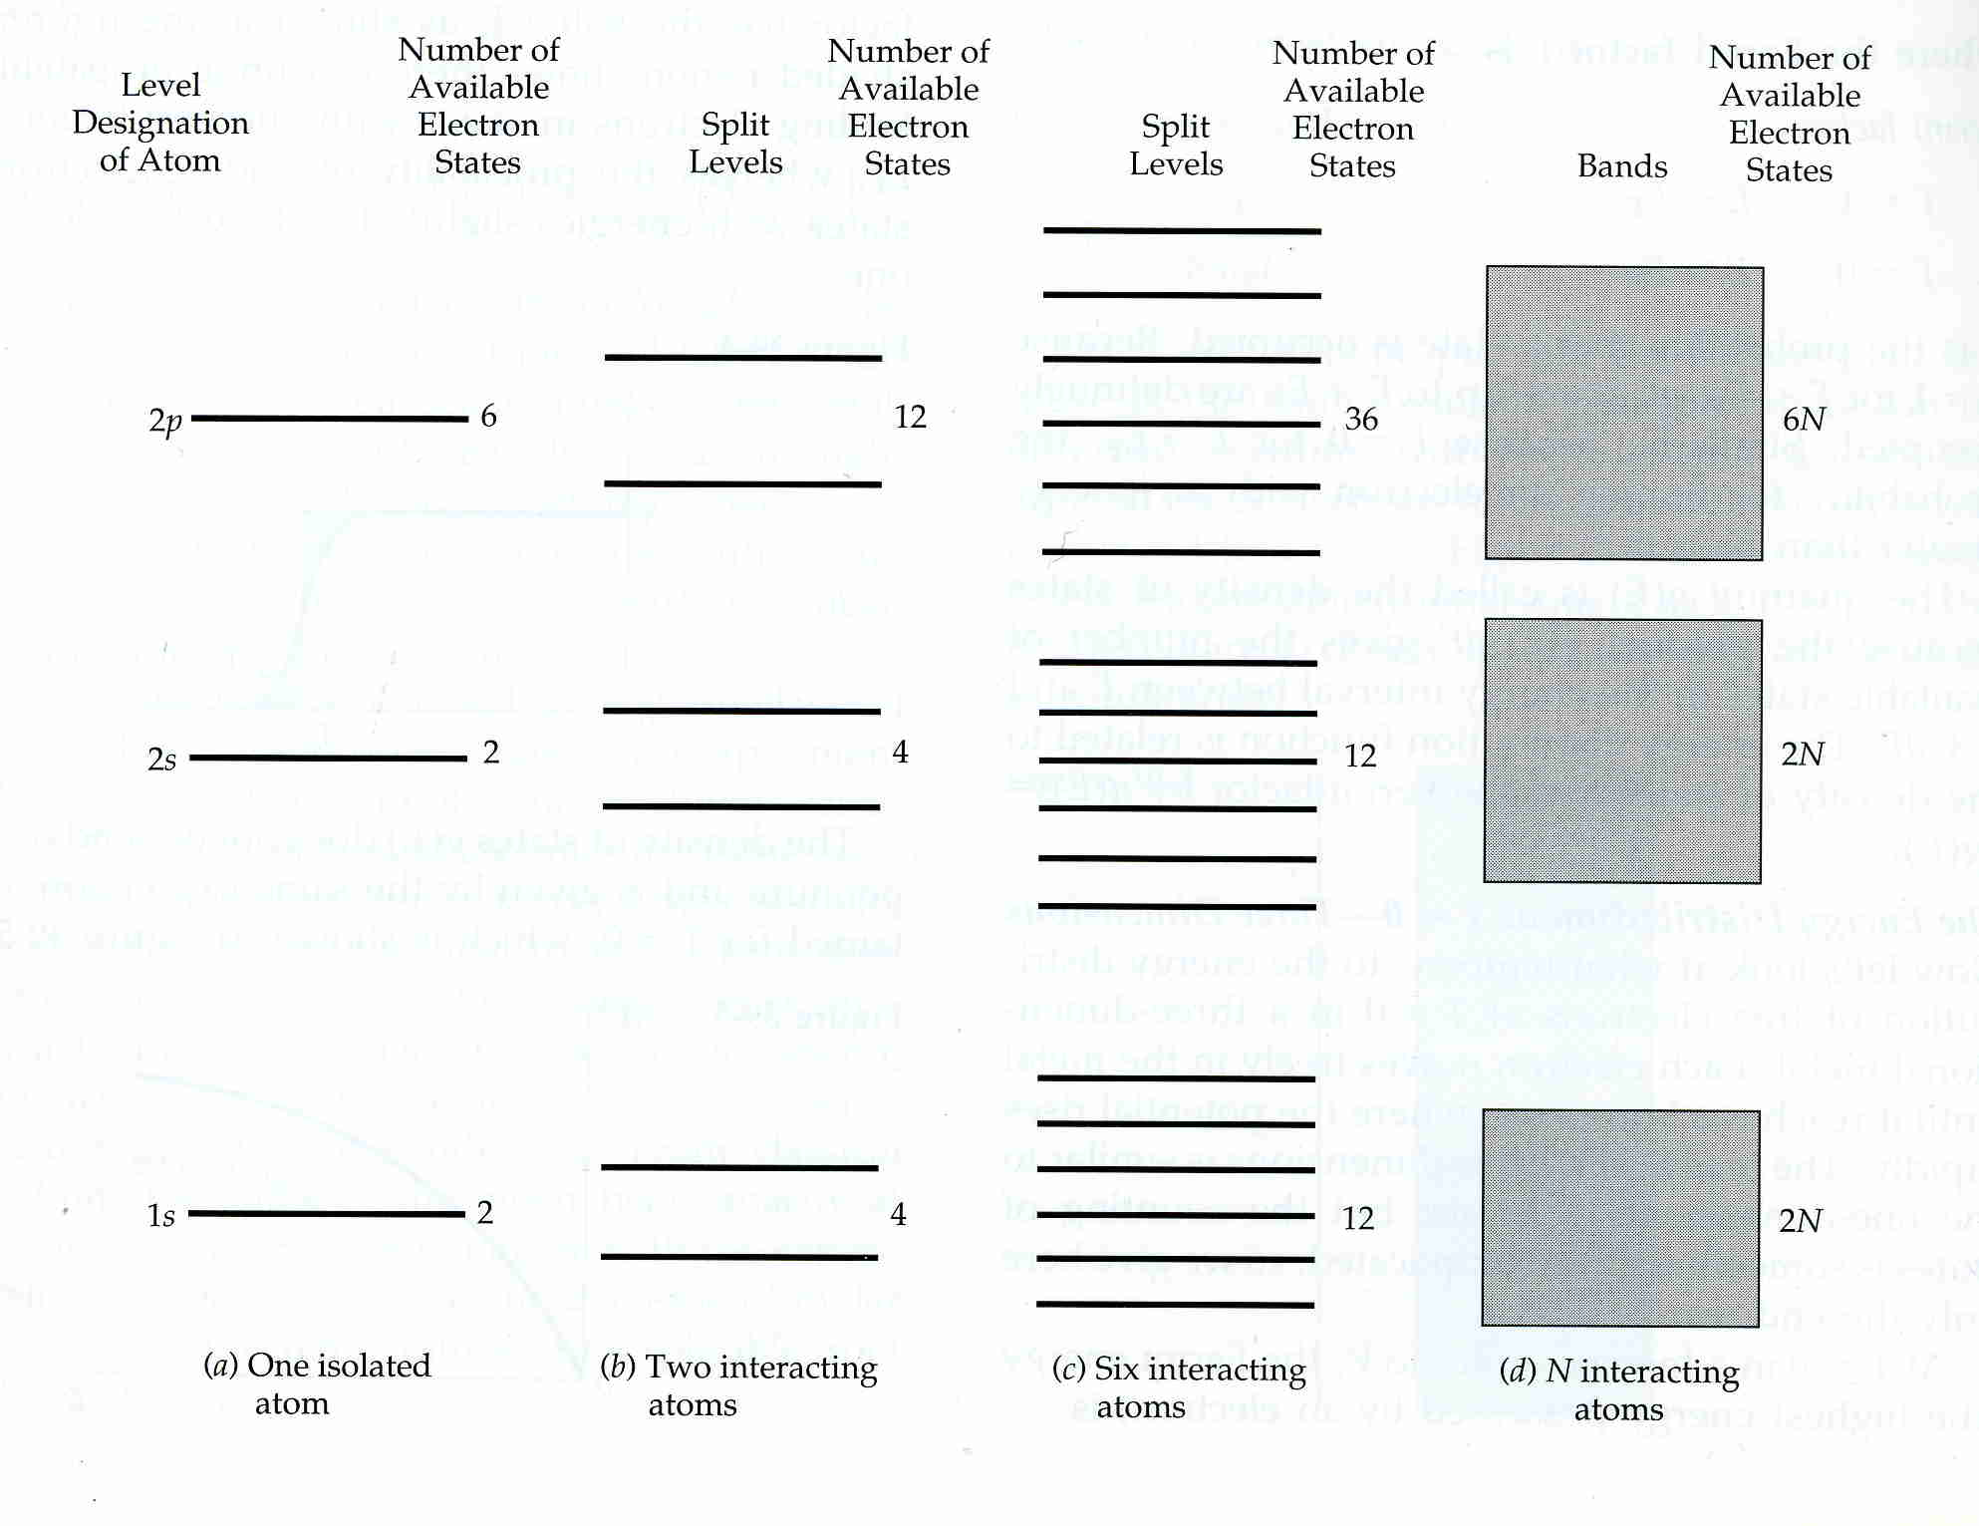

Slide 4
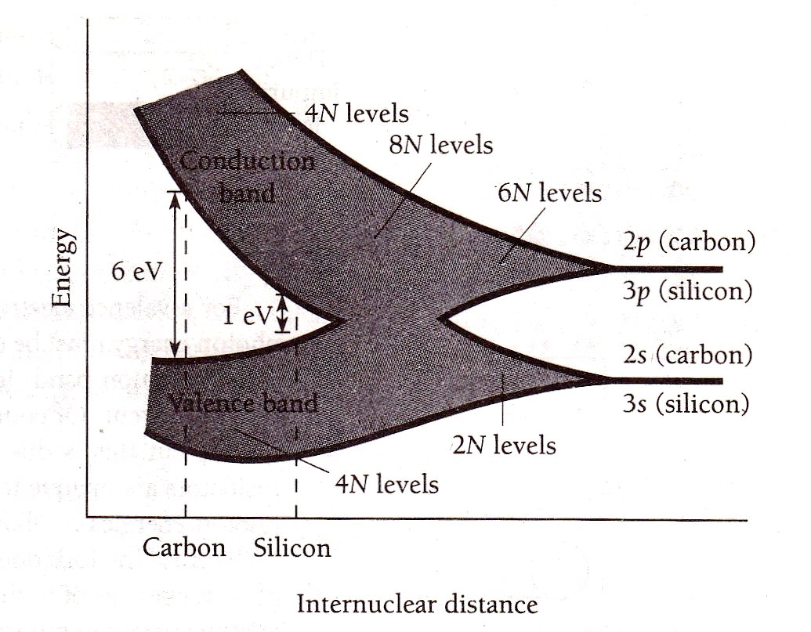
Splitting of Atomic Levels in Carbon

Slide 5
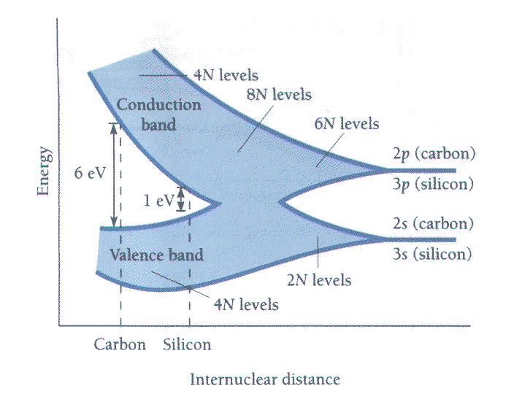
Figure shows energy bands in carbon (and silicon) as a function of interatomic separation.
At large separation, there is a filled 2s band and a 1/3 filled 2p band.
Splitting of Atomic Levels in Carbon
But electron energy can be lowered if the carbon-carbon separation is reduced.
There is a range of carbon-carbon separations for which the 2s and 2p bands overlap and form a hybrid band containing 8N states (levels).

Slide 6
But the minimum total electron energy occurs at this carbon carbon separation.
At this separation there is a valence band containing 4N quantum states and occupied by 4N electrons.
The filled band is separated by a large gap from the empty conduction band. The gap is 6 eV—remember, kT is about 0.025 eV at room temperature. The gap is too large for ordinary electric fields to move an electron into the conduction band. Carbon is an insulator. That is not the case with Silicon!

Slide 7
Insulators, Semiconductors, and Metals (continued)
Conduction Band
Valence Band
Conductor
Semiconductor
Insulator

Slide 8
CLASSIFICATION OF MATERIALS
Based on ‘band theory’, solids can be classified into three categories, namely,
Insulators,
semiconductors &
conductors.

Slide 9
Insulators, Semiconductors, and Metals
The separation of the valence and conduction bands determines the electrical properties of the material
Insulators have a large energy gap
electrons can’t jump from valence to conduction bands
no current flows
Conductors (metals) have a very small (or nonexistent) energy gap
electrons easily jump to conduction bands due to thermal excitation
current flows easily
Semiconductors have a moderate energy gap
only a few electrons can jump to the conduction band
leaving “holes”
only a little current can flow

Slide 10
CONDUCTORS
Conduction and valence bands are overlapped
Abundant free electrons already exist in the conduction band at room temperature hence conductivity is high.
The resistivity increases with temperature as the mobility of already existing electrons will be reduced due to collisions.
Metals are best examples.

Slide 11
INSULATORS
Bad conductors of electricity
Conduction band is empty and valence band is full, and these band are separated by a large forbidden energy gap.
The best example is Diamond with E_{g}=7ev.

Slide 12
SEMICONDUCTORS
Forbidden gap is less
Conduction band and valence band are partially filled at room temperature.
Conductivity increases with temperature as more and more electrons cross over the small energy gap.
Examples Si(1.1eV) & Ge(0.72eV)

Slide 13
Conductors, semiconductors and insulators

Slide 14
SEMICONDUCTORS
A semiconductor is a material with conducting properties
between those of a good insulator (e.g. glass) and a good
conductor (e.g. copper). Ex: Si, Ge, GaAs etc.
Energy band gap around 1 eV.
At absolute zero, all energy states in the valence band are
full and all states in the conduction band are empty. Hence
pure semiconductors are insulators at zero temperature.
At room temperature however, some of the valence
electrons acquire thermal energy greater than E_{g} and cross
over into the conduction band.
These free electrons, and the holes created in the valence
band, can move about even under a small applied field.

Slide 15
Widely used in……
computers  air bags  Palm pilots  cell phones
pagers  DVD players TV remotes  satellites
▪ fiber networks  switches  photocells  Peltier
refrigerators  thermoelectric generators  lasers
aerospace electronics CD players  televisions
▪ flat panel displays  clocks  amplifiers  logic
circuits  temperature sensors  calculators
millimeter-wave radar  synthesizers
▪ portable computer drives  digital cameras  etc.

Slide 16
Holes and Intrinsic Semiconductors
When electrons move into the conduction band, they leave behind vacancies in the valence band. These vacancies are called holes. Because holes represent the absence of negative charges, it is useful to think of them as positive charges.
Whereas the electrons move in a direction opposite to the applied electric field, the holes move in the direction of the electric field.
A semiconductor in which there is a balance between the number of electrons in the conduction band and the number of holes in the valence band is called an intrinsic semiconductor.
Examples of intrinsic semiconductors include pure carbon and germanium.

Slide 17
Semiconductors
Each silicon atom has an outer shell with four valence electrons and four vacancies (It is a tetravalent element).
In intrinsic (pure) silicon, atoms join together by forming covalent bonds. Each atom shares its valence electrons with each of four adjacent neighbours effectively filling its outer shell.

Slide 18
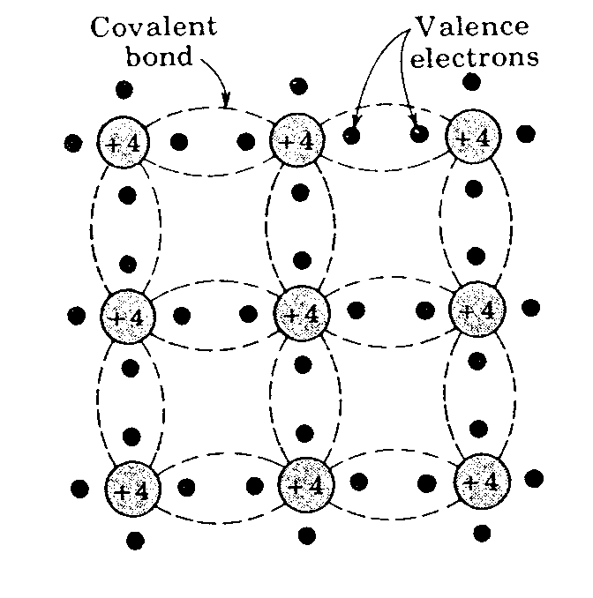
Intrinsic Semiconductors

Slide 19
Intrinsic Semiconductors
The structure has zero overall charge
The complete nature of the structure means that at absolute zero temperature (0 K) none of the electrons is available for conduction…thus far the material is an insulator.

Slide 20
Intrinsic Semiconductors
At room temperature some of the electrons are able to acquire sufficient thermal energy to break free from their bond.
Whenever an electron leaves its position in the lattice it leaves a vacancy known as a hole.
The process is known as electron-hole pair generation

Slide 21
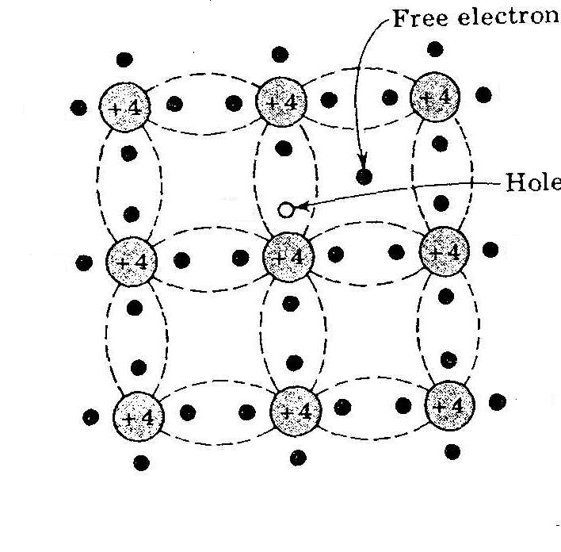
Intrinsic Semiconductors

Slide 22
Intrinsic Semiconductors
A freed electron can move through the body of the material until it encounters another broken bond where it is drawn in to complete the bond or recombines.

Slide 23
Intrinsic Semiconductors
At a given temperature there is a dynamic equilibrium between thermal electron-hole generation and the recombination of electrons and holes
As a result the concentration of electrons and holes in an intrinsic semiconductor is constant at any given temperature.
The higher the temperature the more electron-hole pairs that are present.

Slide 24
Intrinsic Semiconductors
Two mechanisms for conduction become possible when a bond breaks:
1. Due to the movement of the freed electron.
2. Due to neighbouring electrons moving into the hole leaving a space behind it. (This can be most simply thought of as movement of the hole, a single moving positive charge carrier even though it is actually a series of electrons that move.

Slide 25
Intrinsic Semiconductors
When an electric field (voltage) is applied, the holes move in one direction and the electrons in the other.
However both current components are in the direction of the field.
The conduction is ohmic, i.e. current is proportional to the applied voltage (field)

Slide 26
Intrinsic Semiconductors
The proportion of freed electrons is very small indeed:
In silicon the energy E_{G} required to free an electron is 1.2eV
The mean thermal energy (kT) is only 25meV at room temperature (1/40 eV)
The proportion of freed electrons varies exponentially (-E_{G} /kT).

Slide 27
Intrinsic Semiconductors
For an intrinsic semiconductor the number of electron and hole carriers, and thus the conductivity, increases rapidly with temperature.
This is not very useful. Only about 10⁹ electrons per cubic centimetre contribute to the conduction of the electric current.
Hence we dope the material to produce an extrinsic semiconductor.

Slide 28

Carriers in Semiconductors
Ec
300º^{K}
Eg
18º^{K}
11º^{K}
14º^{K}
15º^{K}
20º^{K}
19º^{K}
12º^{K}
13º^{K}
17º^{K}
16º^{K}
4º^{K}
1º^{K}
2º^{K}
0º^{K}
3º^{K}
10º^{K}
5º^{K}
6º^{K}
7º^{K}
8º^{K}
9º^{K}
Ev
Electron Hole Pair
E
H
P

Slide 29
Extrinsic Semiconductors
Instrinsic conduction is very small.
Conductivity levels can be raised and controlled by doping with minute levels of impurity atoms to give extrinsic or doped semiconductors.
Extrinsic semiconductors may be further divided into either n-type or p-type

Slide 30
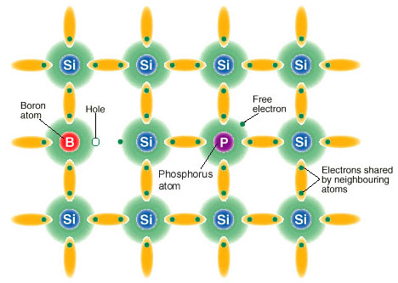

Slide 31
N-type Semiconductors
An n-type impurity atom has five outer (valence) electrons, rather than the four of silicon.
Only four of the outer electrons are required for covalent bonding. The fifth is much more easily detached from the parent atom.
As the energy needed to free the fifth electron is smaller than the thermal energy at room temperature virtually all are freed.

Slide 32
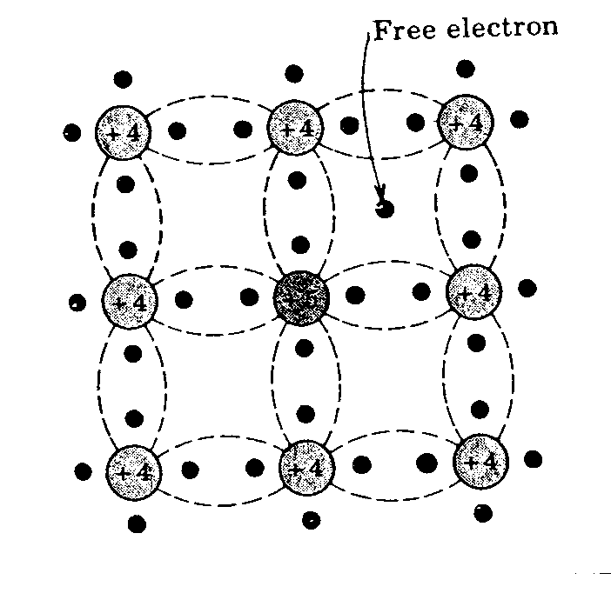
N-type Semiconductors
EXTRA ELECTRON FREE AT ROOM TEMP.
+4
+4
+4
+4
+5
+4
+4
+4
+4

Slide 33
P-type Semiconductors
Here the doping atom has only three electrons in its outer shell.
It is relatively easy for an electron from a neighbouring atom to move in, so releasing a hole at its parent atom. The freed hole is available for conduction.
The energy needed to free the electron from its parent is usually small compared to the thermal energy so each impurity atom contributes one hole for conduction (fully ionised).

Slide 34
P-type Semiconductors

Slide 35
Extrinsic Material
V
P
As
Sb
Ec
Ed
50º^{K}
18º^{K}
11º^{K}
14º^{K}
15º^{K}
20º^{K}
19º^{K}
12º^{K}
13º^{K}
17º^{K}
16º^{K}
4º^{K}
1º^{K}
2º^{K}
0º^{K}
3º^{K}
10º^{K}
5º^{K}
6º^{K}
7º^{K}
8º^{K}
9º^{K}
Ev
Donor

Slide 36
Extrinsic Material
ш
B
Al
Ga
In
Ec
50º^{K}
18º^{K}
11º^{K}
14º^{K}
15º^{K}
20º^{K}
19º^{K}
12º^{K}
13º^{K}
17º^{K}
16º^{K}
4º^{K}
1º^{K}
2º^{K}
0º^{K}
3º^{K}
10º^{K}
5º^{K}
6º^{K}
7º^{K}
8º^{K}
9º^{K}
Ea
Ev
Acceptor

Slide 37
Summary
In an N-type semiconductor, conduction is mainly due to electrons (negative charges)
Positive charges (holes) are the minority carriers.
In a P-type semiconductor, conduction is mainly due to holes (positive charges)
Negative charges (electrons) are the minority carriers.

Slide 38
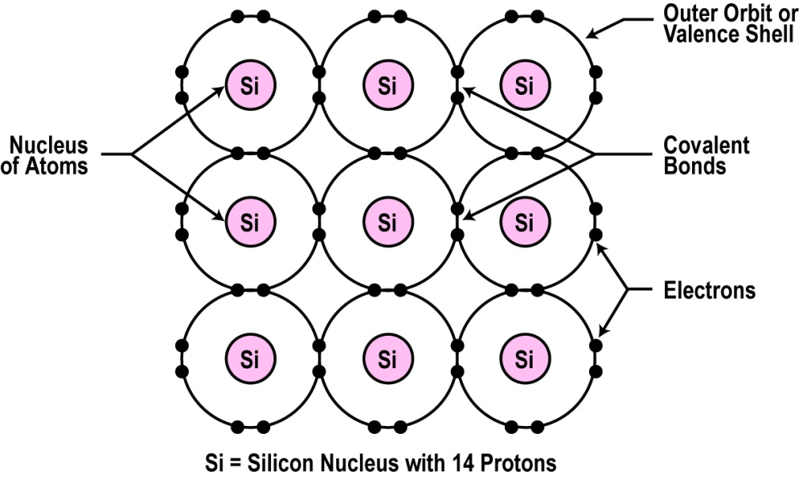
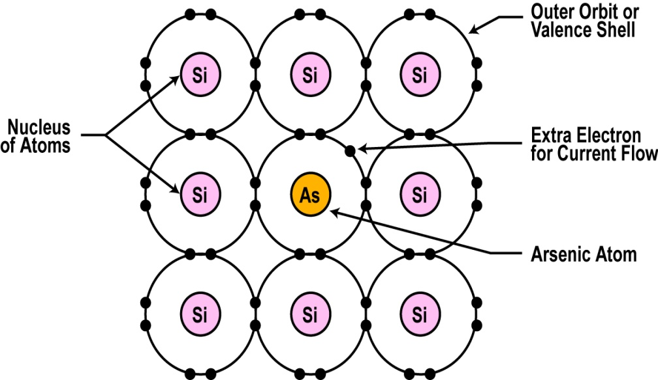
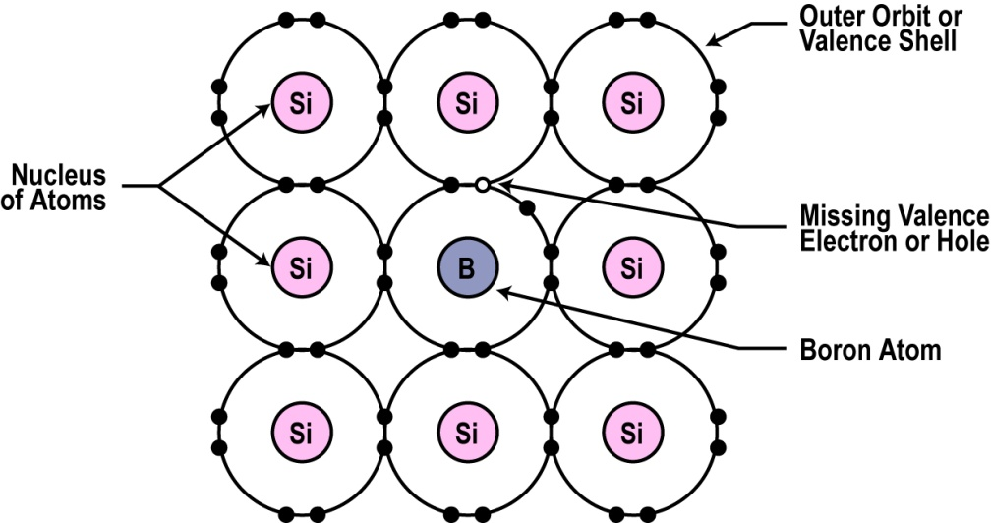
Intrinsic and Extrinsic (n-, p- type) Semiconductors

Slide 39
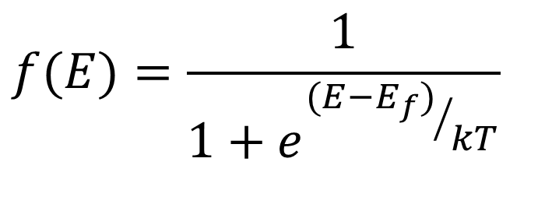
The Fermi Level
$$f(E)=\frac{1}{1+e^{{(E−E_{f})}/{kT}}}$$
k : Boltzmann’s constant
f(E) : Fermi-Dirac distribution function
E_{f} : Fermi level

Slide 40
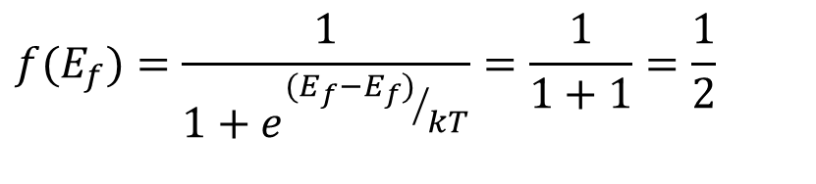
3-3-1. The Fermi Level
$$f(E_{f})=\frac{1}{1+e^{{(E_{f}−E_{f})}/{kT}}}=\frac{1}{1+1}=\frac{1}{2}$$
f(E)
1
T=0ºK
T₁>0ºK
T₂>T₁
1/2
E
E_{f}

Slide 41
3-3-1. The Fermi Level
E
f(E_{c})
f(E_{c})
E_{c}
E_{f}
[1-f(E_{c})]
E_{v}
≈
≈
f(E)
Intrinsic
p-type
n-type
1
1/2
0

Slide 42
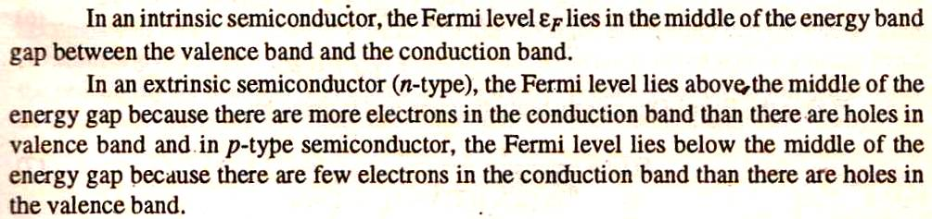
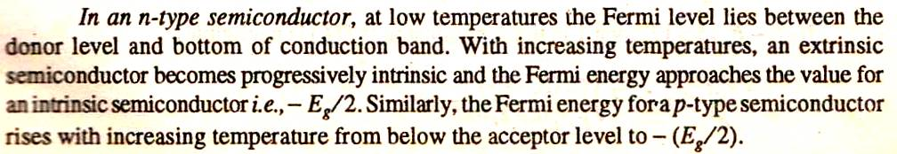

Slide 43
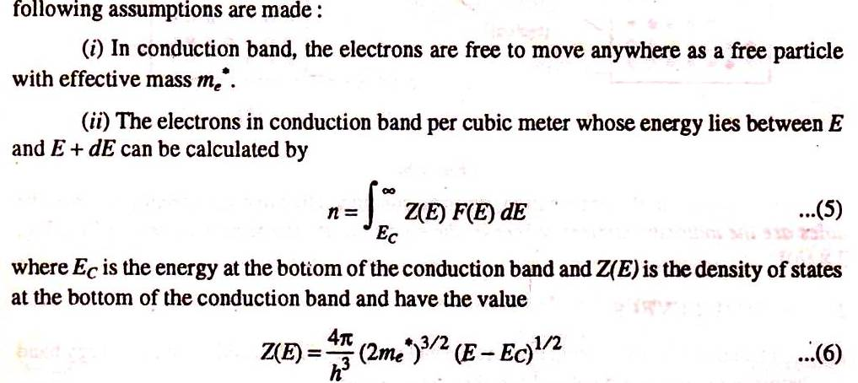
Carrier density in semiconductor
1. Concentration of electrons in conduction band:

Slide 44
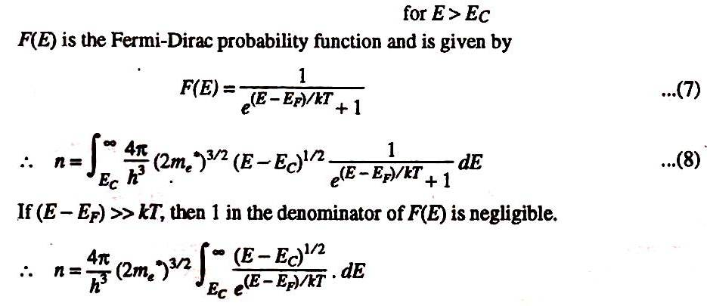
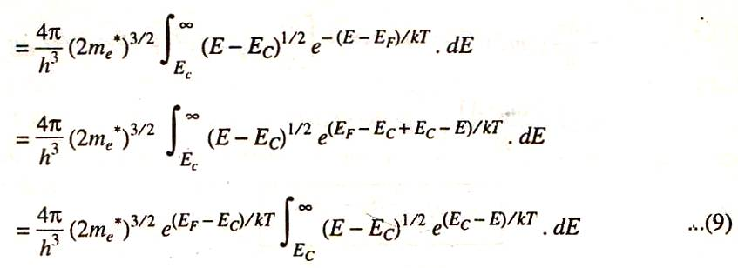

Slide 45
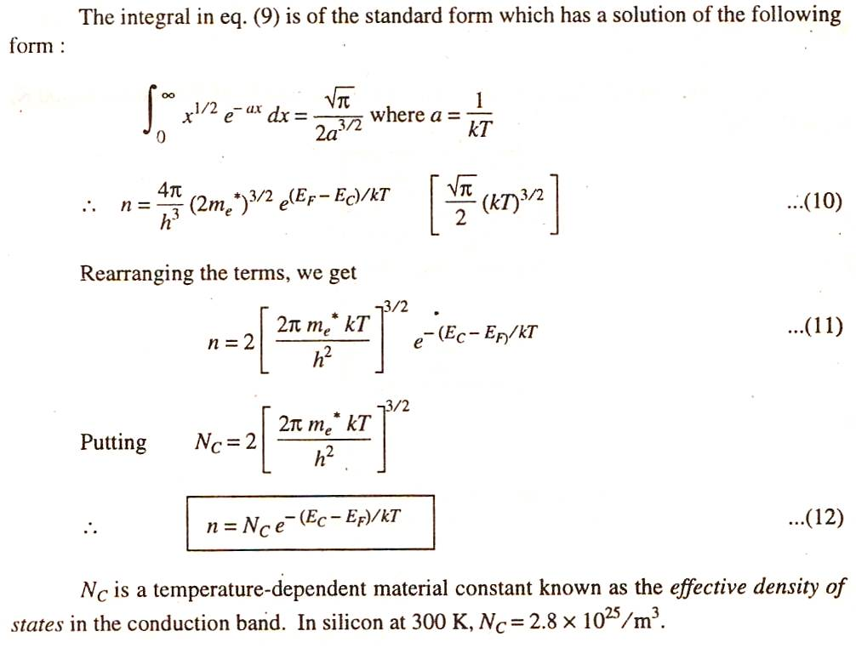

Slide 46
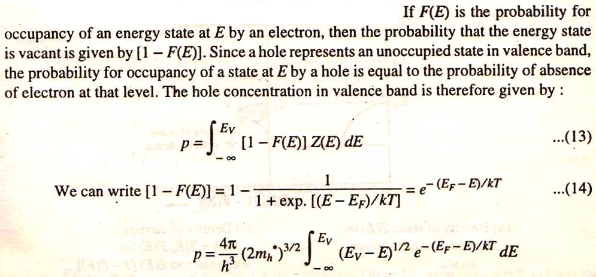
2. Concentration of holes in valence band:

Slide 47
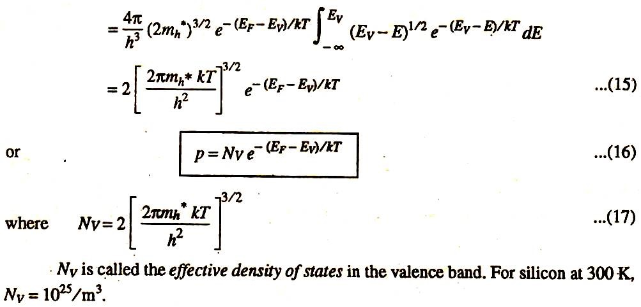

Slide 48
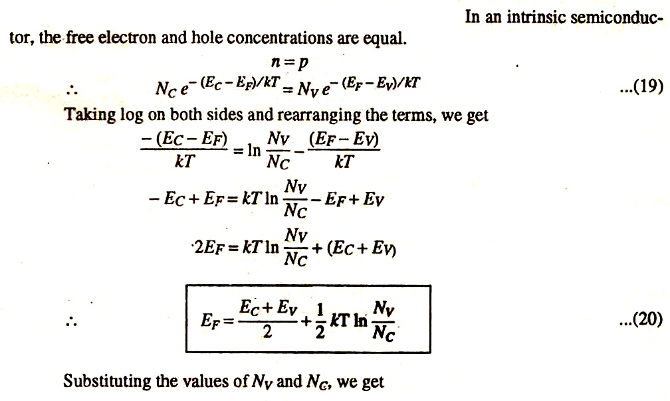
Fermi level in intrinsic semiconductor

Slide 49
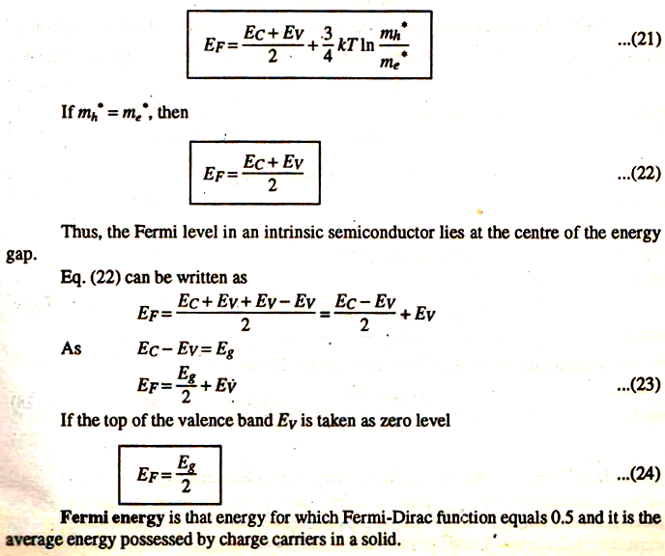

Slide 50
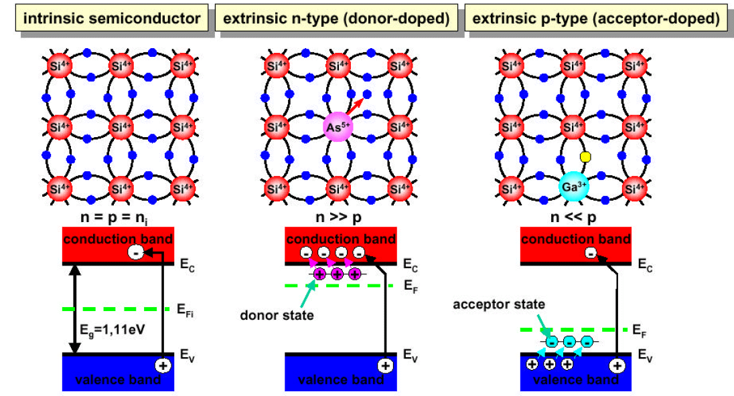
Summary

Slide 51
Drift and Diffusion current in semiconductors:

Slide 52
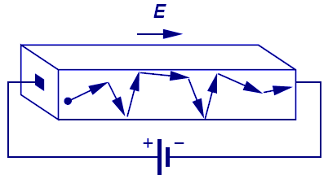
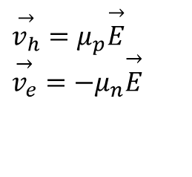
Carrier Drift
The process in which charged particles move because of an electric field is called drift.
Charged particles within a semiconductor move with an average velocity proportional to the electric field.
The proportionality constant is the carrier mobility.
$$\overset{→}{v_{h}}=μ_{p}\overset{→}{E} \\ \overset{→}{v_{e}}=−μ_{n}\overset{→}{E}$$
Hole velocity
Electron velocity
Notation:
μ_{p} ≡ hole mobility (cm²/V·s)
μ_{n} ≡ electron mobility (cm²/V·s)

Slide 53
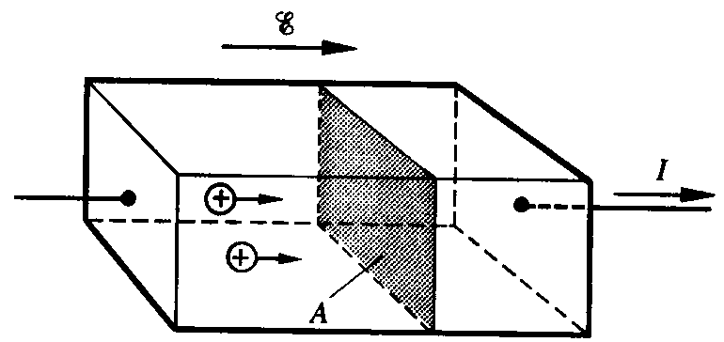
Drift Current
Drift current is proportional to the carrier velocity and carrier concentration:
v_{h} t A = volume from which all holes cross plane in time t
p v_{h} t A = # of holes crossing plane in time t
q p v_{h} t A = charge crossing plane in time t
q p v_{h} A = charge crossing plane per unit time = hole current
Hole current per unit area (current density) J_{p,drift} = q p v_{h}
Similar result can be written for electrons as well

Slide 54
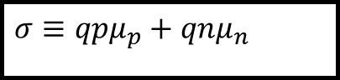
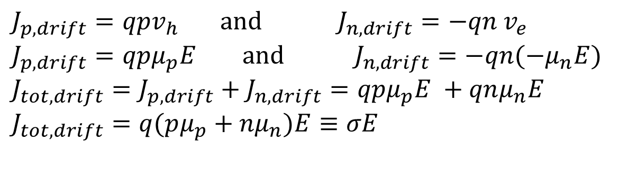
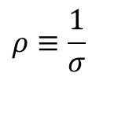
Conductivity and Resistivity
In a semiconductor, both electrons and holes conduct current:
The conductivity of a semiconductor is
Unit: mho/cm
The resistivity of a semiconductor is
Unit: ohm-cm
$J_{p,drift}=qpv_{h} \text{and} J_{n,drift}=−qn$ $v_{e}$
$$J_{p,drift}=qpμ_{p}E \text{and} J_{n,drift}=−qn(−μ_{n}E) \\ J_{tot,drift}=J_{p,drift}+J_{n,drift}=qpμ_{p}E +qnμ_{n}E \\ J_{tot,drift}=q(pμ_{p}+nμ_{n})E≡σE$$
$$σ≡qpμ_{p}+qnμ_{n}$$
$$ρ≡\frac{1}{σ}$$

Slide 55
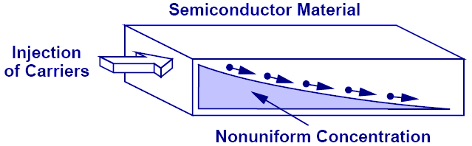
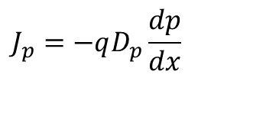
Carrier Diffusion
Due to thermally induced random motion, mobile particles tend to move from a region of high concentration to a region of low concentration.
Analogy: ink droplet in water
Current flow due to mobile charge diffusion is proportional to the carrier concentration gradient.
The proportionality constant is the diffusion constant.
$$J_{p}=−qD_{p}\frac{dp}{dx}$$
Notation:
D_{p} ≡ hole diffusion constant (cm²/s)
D_{n} ≡ electron diffusion constant (cm²/s)

Slide 56
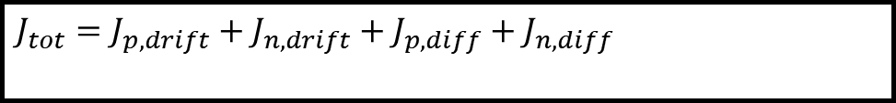
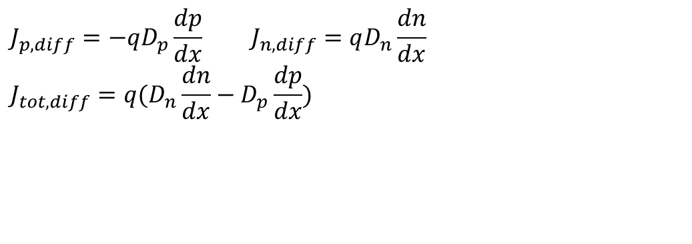
Diffusion Current
Diffusion current within a semiconductor consists of hole and electron components:
The total current flowing in a semiconductor is the sum of drift current and diffusion current:
$$J_{p,diff}=−qD_{p}\frac{dp}{dx} J_{n,diff}=qD_{n}\frac{dn}{dx} \\ J_{tot,diff}=q(D_{n}\frac{dn}{dx}−D_{p}\frac{dp}{dx})$$
$$J_{tot}=J_{p,drift}+J_{n,drift}+J_{p,diff}+J_{n,diff}$$

Slide 57
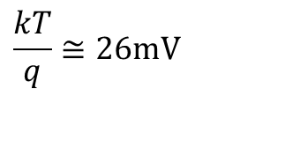
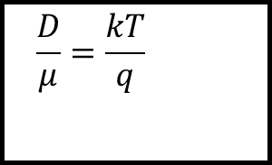
The Einstein Relation
The characteristic constants for drift and diffusion are related:
Note that at room temperature (300K)
This is often referred to as the “thermal voltage”.
$$\frac{D}{μ}=\frac{kT}{q}$$
$$\frac{kT}{q}≅26\text{mV}$$

Slide 59
Hall Effect When a current carrying conductor is placed in a transverse magnetic field than a potential difference appears in the conductor in the third mutually perpendicular direction

Slide 60
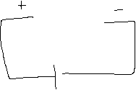

When electrons flow without magnetic field...
semiconductor slice
t
_
+
d
I
I

Slide 61
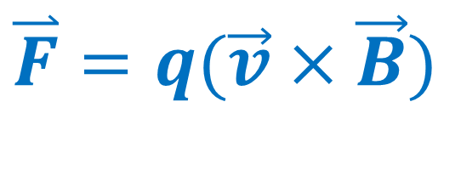
When the magnetic field is turned on ...
I
qBv
$$\overset{⃑}{F}=q(\vec{v}×\vec{B})$$
B-field

Slide 62
As time goes by...
high
potential
qE_{H}
I
low
potential
qBv = qE_{H}

Slide 63
Finally...
Hall Voltage
V
H
I
B-field

Slide 64
Hall Effect
Let’s find out:
1. Hall field
2. Hall Coefficient
3. Mobility
4. Hall angle

Slide 65
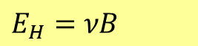
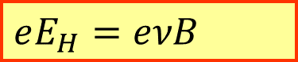
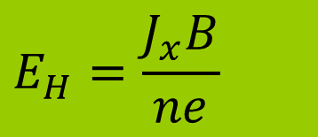
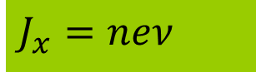
Hall field
A potential difference is established from top to bottom of the specimen with bottom face negative. This p. d. causes a field E_{H} in the – ve y-direction, and there is a force of eE_{H} acting in the upward direction on the electron . At equilibrium
and ………1
If J_{x} is the current density in x-direction, then
………… 2
Where n is the concentration of current carriers, combining 2 and 3
………….3
$$eE_{H}=eνB$$
$$E_{H}=νB$$
$$J_{x}=neν$$
$$E_{H}=\frac{J_{x}B}{ne}$$

Slide 66
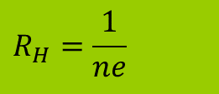
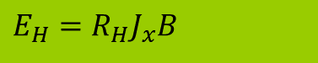
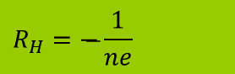
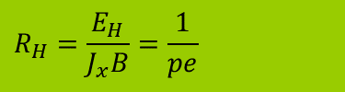
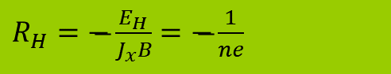
Hall coefficient
Hall field per unit current density per unit magnetic induction is called Hall coefficient R_{H}
R_{H}=E_{H}/(J_{x}B)
....….3 Where ………….4
But in present case as electron are charge carriers,
……….5
i.e. Hall coefficient is –ve. Here – ve sign is used because the electric field developed is in the – ve y-direction. So
………….6
All the three quantities can be measured. So the Hall coefficient and carrier density ‘n’ can be determined . The Hall coefficient is just a proportionality between the Hall field and product J_{x}B.
In p-type semiconductor the current is entirely by holes . So
………7
$$R_{H}=\frac{1}{ne}$$
$$E_{H}=R_{H}J_{x}B$$
$$R_{H}=\overset{̶}{−}\frac{1}{ne}$$
$R_{H}=\overset{̶}{−}\frac{E_{H}}{J_{x}B}=\overset{̶}{−}\frac{1}{ne}$
$$R_{H}=\frac{E_{H}}{J_{x}B}=\frac{1}{pe}$$

Slide 67

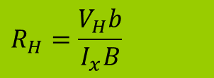
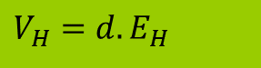
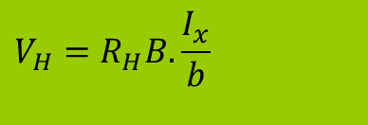
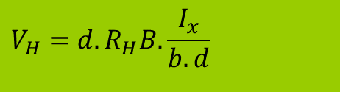

Hall Coefficient
If V_{H} is the Hall voltage developed across the specimen of thickness ‘d’, then
Putting the value of E_{H} from eq..3 we get
If ‘b’, is the width of the specimen , then ’bd’ will be cross-sectional area and current density is given as
Thus
Or
……….13
R_{H} can be measured experimentally when V_{H}, I_{x}, B and b are known. V_{H} will have opposite polarity for ‘n’ and ‘p’ type semiconductors.
$$V_{H}=d.E_{H}$$
$$V_{H}=d.R_{H}J_{x}B$$
$$J_{x}=\frac{I_{x}}{b.d}$$
$$V_{H}=d.R_{H}B.\frac{I_{x}}{b.d}$$
$$V_{H}=R_{H}B.\frac{I_{x}}{b}$$
$$R_{H}=\frac{V_{H}b}{I_{x}B}$$

Slide 68










Mobility
When the current carrying particles acquire a velocity per unit electric field , the velocity is known as mobility and represented by µ.
Or …………8
From equation..(1) therefore
Or ……….9
Comparing E_{H} from equation…(3) and (9),we get
Or
But is the electrical conductivity, ……..10
Or using eq…2
$$μ=\frac{ν}{E}$$
$$ν=μE$$
$$ν=\frac{E_{H}}{B}$$
$$\frac{E_{H}}{B}=μE$$
$$E_{H}=μEB$$
$$R_{H}J_{x}B=μEB$$
$$μ=\frac{R_{H}J_{x}}{E}$$
$$\frac{J_{x}}{E}=σ$$
$$μ=σR_{H}$$
$$μ=\frac{E_{H}}{J_{x}B}σ$$

Slide 69






Hall angle
and
Thus
Or
Or ……..11
Where is called Hall angle.
Therefore ……..12
$$J_{x}=σE$$
$$μ=\frac{E_{H}}{σEB}σ$$
$$μ=\frac{E_{H}}{E}×\frac{1}{B}$$
$$μ=φ×\frac{1}{B}$$
$$φ=\frac{E_{H}}{E}$$
$$φ=μB$$

Slide 70
PN Junction
The discovery of the p–n junction is usually attributed to American physicist Russell Ohl of Bell Laboratories in 1950^{s}

Slide 71
Forming a p-n Junction
Doping one side of a piece of silicon with boron (a p-type dopant-trivalent impurity) and the other side with phosphorus (an n-type dopant-pentavalent impurity) forms a p-n junction.
First, however, consider two separate pieces of silicon - one being n-type, the other being p-type.

Slide 72

The n-type material has the large numbers of free electrons (negatively charged) that can move through the material.
Similarly, for the p-type material, there are large numbers of free holes (positively charged) that can move through the material.
Now imagine that the n-type and the p-type materials are brought together.

Slide 73


Slide 74
Due to this combination there will be a small electrical imbalance inside the semiconductor crystal.
Since the N region is missing some electrons it has obtained a positive charge.
And the extra electrons that filled the holes in the P region, have given it a negative charge.

Slide 75



Different views of junction formation

Slide 76

Forward biasing

Slide 77

Reverse biasing

Slide 78

The characteristic properties of pn junction will be apparent (visible) by just making a contact of a p-type block with a n-type block ?
“No”
In fact, pn junction is fabricated by special techniques. One common method of making pn junction is called alloying

Slide 79

In this method, a small block of indium (trivalent impurity) is placed on an n-type germanium slab
The system is then heated to a temperature of about 500ºC. The indium and some of the germanium melt to form a small puddle of molten germanium-indium mixture.

Slide 80

The temperature is then start to lowered and the puddle begins to solidify. Under proper conditions, the atoms of indium impurity will be suitably adjusted in the germanium slab to form a single crystal.
The addition of indium overcomes the excess of electrons in the n-type germanium to such an extent that it creates a p-type region.
You must remember

Slide 81

The nature of the p–n junction formed may, in general, be of two types:
A step-graded junction:-
A linearly-graded junction:-

Slide 82
Step graded junction:
For a step graded junction, there is an unexpected change, say, from acceptor ions on one side to donor ions on the other side of the junction.
This type of junction is formed by placing a trivalent impurity ( such as Indium) against n-type Ge and heating the combination for a short time.
Some of the Indium atoms dissolve into the n-type Ge and converts it into p-type Ge. This type of step graded junction is called as alloy or fusion junction. Such a junction is usually formed between the emitter and the base of a planar transistor.

Slide 84

Linearly-graded junction

Slide 85
For processes in which the junction is annealed over a long period of time, impurities will migrate and diffuse further across the transition region, which tends to make the junction transition more gradual.

Slide 86

Let’s first review the properties of most commonly used p-n junction diode.

Slide 87


Diodes usually come in glass or plastic cylindrical packages, marked with a stripe on one side to indicate polarity.
In a perfectly ideal diode, current flows in one direction only, from the anode (positive side) to the cathode (negative side) which is marked with the stripe.

Slide 88


I-V Characteristics of a P-N Junction diode
(i) Forward Biased
(ii) Reversed Biased

Slide 89
Forward biasing
If positive terminal of battery is connected to the P-region and negative to N-region, junction is called forward biased because it permits easy flow of current across the junction.
When external voltage applied to the P-N junction is in such a direction that it cancels the potential barrier, thus permitting current flow, it is called forward biasing. During forward biasing the depletion region width is reduced.
Due to electrical force of source, both electrons and holes are driven towards the junction where they recombine and complete circuit.
The flow of electrons from N-type to P-type can be maintained with the help of external power source.
Low resistance in the forward direction.

Slide 90


Slide 91
Reverse biasing
If positive terminal of battery is connected to the N-region and negative to P-region, junction is called reverse biased.
When the external voltage applied to the P-N junction is in such a direction that potential barrier is increased, is called reverse biasing.
Reverse voltage establishes an electric field which act in same direction as the field due to potential barrier.
The increased potential barrier prevents the flow of majority charge carriers across the junction, thus a high resistance path is established.
Under reverse bias, no current due to majority carriers, yet small current (a few μA for Ge and nA for Si) due to minority carriers.

Slide 92


Slide 93
V/I Characteristics
Forward characteristics
In Ge, upto 0.3 V no reasonable current flows .
A potential difference of about 0.3 V is required for forward current to flow. This is known as threshold voltage/ cut-in voltage or knee voltage. It is practically same as barrier voltage.
As applied voltage increases beyond the threshold value, the forward current increases sharply.

Slide 94
V/I Characteristics
Reverse characteristics
As reverse voltage is increased from zero, the reverse current rises to its maximum value.
This gives rise to a very small current called surface leakage current.
In reverse biasing the current flows due to the drift of minority charge carriers.

Slide 95


Slide 96


Slide 97
Diode Current
The general characteristics of a semiconductor diode can be defined by the following equation, referred to as Shockley’s equation, for the forward and reverse bias regions.
I=I_{s} (e ^{eV/ηKT}-1) ampere…………………..1
I_{s} = diode reverse saturation current
V=voltage across junction, positive for forward and negative for reverse bias
K= Boltzman’s constant = 1.38X10⁻²³ J/K
T= crystal temperature in Kelvin
η = 1 for germanium
η = 2 for Silicon

Slide 98
For positive value of V (forward Bias) the first term of equation 1 will grow very quickly and totally overpowers the effect of the second term.
I ≈ I_{s}e ^{eV/ηKT}
For negative value of V (reverse Bias) the exponential term drops very quickly.
I ≈ I_{s}

Slide 99

Zero Biasing (Without Biasing)

Slide 100

Forward Biased

Slide 101

Reverse Biased

Slide 102


Applications of Junction Diode
Junction diode can be used as rectifier
Half Wave Rectifier
Full Wave Center Tape Rectifier

Slide 103

BRIDGE RECTIFIER

Slide 104

Zener diode
Zener diode is fabricated by heavily doping both p-, and n- sides of the junction. Due to this, depletion region formed is very thin (<10^{–6} m) and the electric field of the junction is extremely high (~5×10⁶ V/m) even for a small reverse bias voltage of about 5V.
The zener diode is a special type of diodes that is designed to work in the reverse breakdown region. Forward characteristics are same as a normal diode.
V_{Z} = Zener breakdown voltage
Zener diode is a main component to design voltage regulator circuit for DC power supply.
Operation region:
Forward bias-operate same as normal diode
Reverse bias-small current flow
Breakdown-big current flow. This is the region where the Zener voltage is constant
For normal diode breakdown voltage is capable to destroy the diode but with zener diode the current is limited by connecting series resistor.

Slide 105

Reverse Breakdown
As the reverse bias voltage increases, the electric field in the depletion region increases. Eventually, it can become large enough to cause the junction to break down so that a large reverse current flows:
breakdown voltage

Slide 106
Zener Breakdown
1. This occurs at junctions which being heavily doped have narrow depletion layers
2. This breakdown voltage sets a very strong electric field across this narrow layer.
3. Here electric field is very strong to rupture the covalent bonds thereby generating electron hole pairs. So even a small increase in reverse voltage is capable of producing large number of current carriers. This leads to Zener breakdown.
Avalanche breakdown
This occurs at junctions which being lightly doped have wide depletion layers.
Here electric field is not strong enough to produce Zener breakdown.
Here minority carriers collide with semi conductor atoms in the depletion region, which breaks the covalent bonds and electron-hole pairs are generated. Newly generated charge carriers are accelerated by the electric field which results in more collision and generates avalanche of charge carriers. This results in avalanche breakdown.

Slide 107

Zener Diode
The Zener is a diode operated in reverse bias at the Zener Voltage (V_{z}).
107

Slide 108

Power dissipation = V_{Z}.I_{Z}
For proper working Zener diode must have:
reverse biasing voltage across > V_{Z}
current in circuit < I_{Zmax}.

